Slide 1
Virtual Instrument:
Heart Rate Indicator
Lab #6
By Socheath Sok

Slide 2
Overview
LabView
Applications
Advantages
Data Acquisition
Prices
Biomedical Toolkit
Heart Rate Indicator
Block Diagram
Front Panel
References

Slide 3

LabView
A system-design platform and development environment for a visual programming language
Created by National Instruments
Applications:
Data acquisition
Instrument control
Industrial automation on a variety of operating systems
[4]

Slide 4
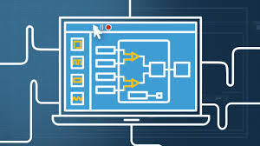
Advantages
Offers a graphical programming approach
Visualization of every aspect of the application
Makes it simple to
Integrate measurement hardware
Represent complex logic on the diagram
Develop data analysis algorithms
Design custom engineering user interfaces.
[4]

Slide 5
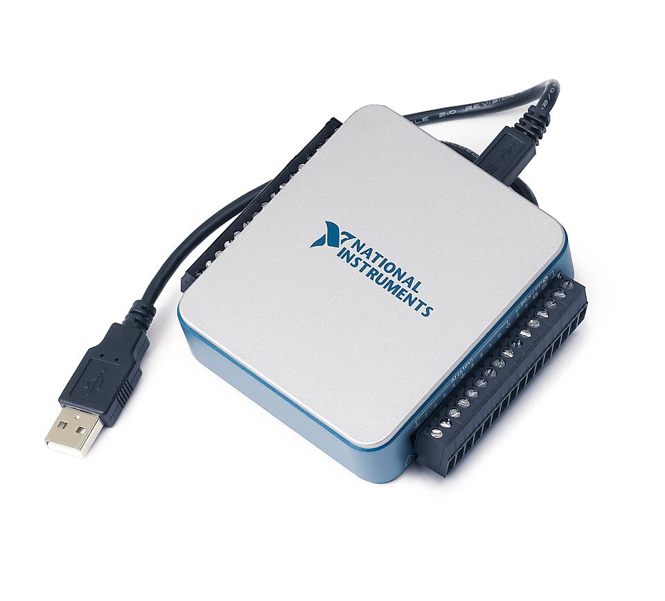
Data Acquisition (DAQ)
Process of measuring an electrical or physical phenomenon such as voltage, current, temperature, pressure, or sound with a computer
DAQ system usually consist of:
Sensor
Device: signal conditioning and ADC
Software
Needed for monitoring biological signals
Signals can be import and analyze in LabView
[3]

Slide 6

Prices
NI DAQ: $170 to $570
Depending on features (sample rate, update rate, input accuracy and resolution, etc)
LabView Software: free for the first 45 days
$3150 to $5300
$400 a year
Academic version: $1325
Additional Libraries
[2]

Slide 7
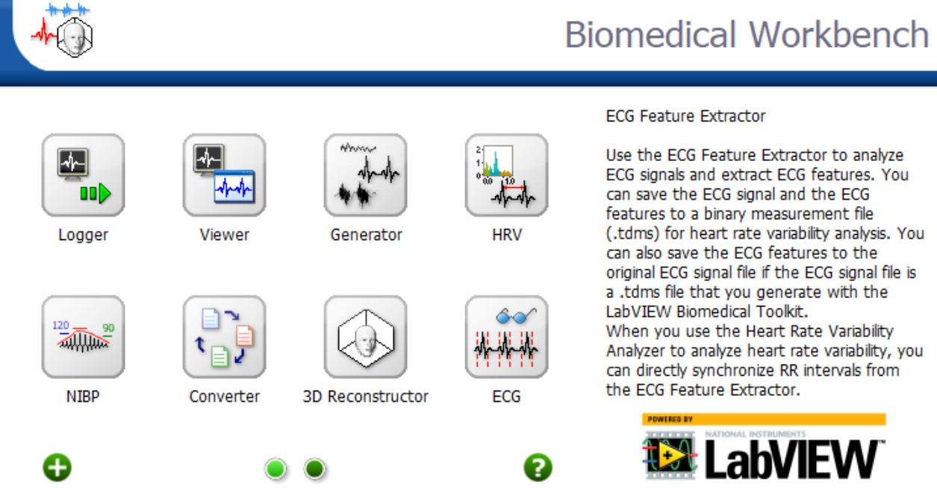
Biomedical Toolkit
A collection of ready-to-run applications, utilities, and algorithms
Designed to simplify the use of LabVIEW software
Focus on:
Data Acquisition
Signal Processing
Image Processing
[2]

Slide 8
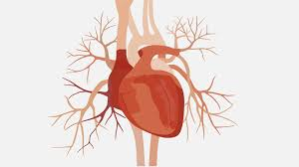
Heart Rate Indicator
Objectives:
Obtain BPM value
Display the heart condition
Background Information:
Heart Rate (BPM):
Normal: 60 to 100
Bradycardia: less than 40
Tachycardia: more than 100

Slide 9
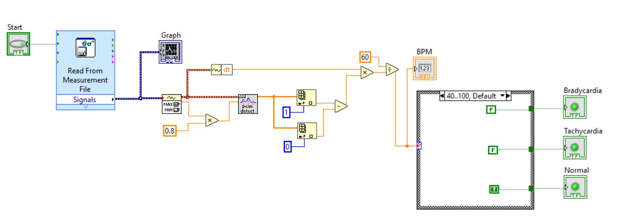
Block Diagram

Slide 10
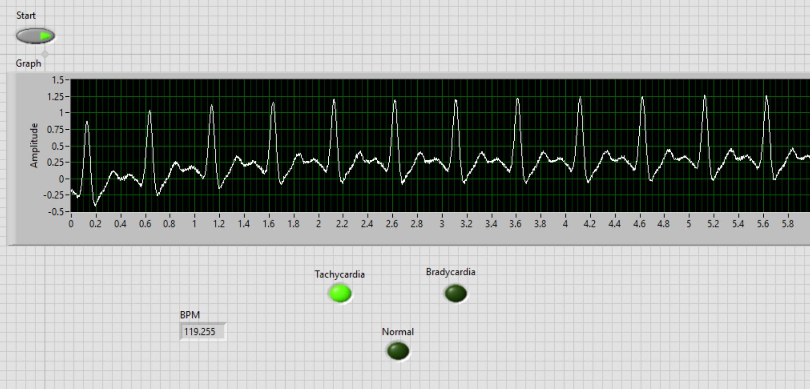
Front Panel Result

Slide 11
[1] Instructables. “ECG and Heart Rate Digital Monitor.” Instructables, Instructables, 12 Dec. 2017,
https://www.instructables.com/id/ECG-and-Heart-Rate-Digital-Monitor/.
[2] NI Low-Cost, Multifunction DAQ Devices - National Instruments,
https://www.ni.com/en-us/landing/low-cost-daq.html.
[3] “What Is Data Acquisition?” What Is Data Acquisition? - National Instruments,
http://www.ni.com/data-acquisition/what-is/?cid=Paid_Search-128994-US_Canada-Google_DAQ1_What_is_DAQ_Sitelinks&s_kwcid=AL!6304!3!243932510569!e!!g!!ni daq&gclid=Cj0KCQiA-4nuBRCnARIsAHwyuPqtcN1lGbPtkKmQoaMD_b47K0jyaPVh6Z9sBy9oxlKmnX-zfCD5SXEaAk8hEALw_wcB.
[4] What Is LabVIEW? - National Instruments, https://www.ni.com/en-us/shop/labview.html.
References

